Slide 1




Article / Speech
[ By NAVEEN SAINI ]

Slide 2

Introduction :-
Article writing is the process of creating a non-fiction text about current or recent news, items of general interest or specific topics. They are published in print formats, such as newspapers and magazines, or online.
Speech Writing is an art of conveying a message to your audience. Either through oral communication or through other means, such as powerpoint slides, speech writing has the same function as normal writing. The reasons for writing are to inform, to explain or to persuade.

Slide 3

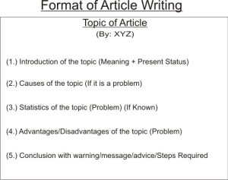
Format of Article :-

Slide 4

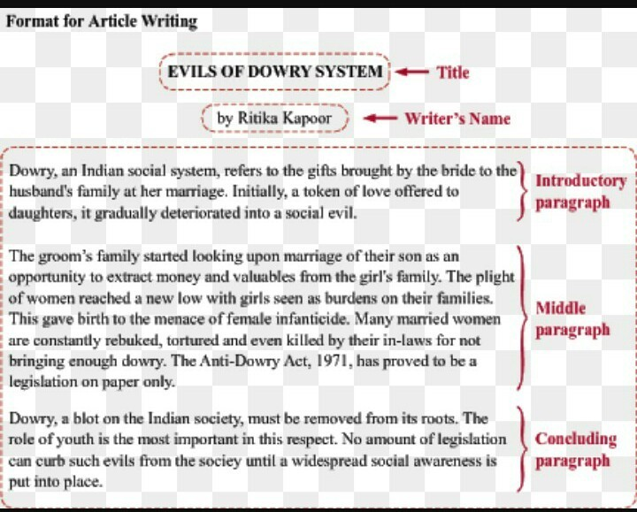
Example of an article :-

Slide 5
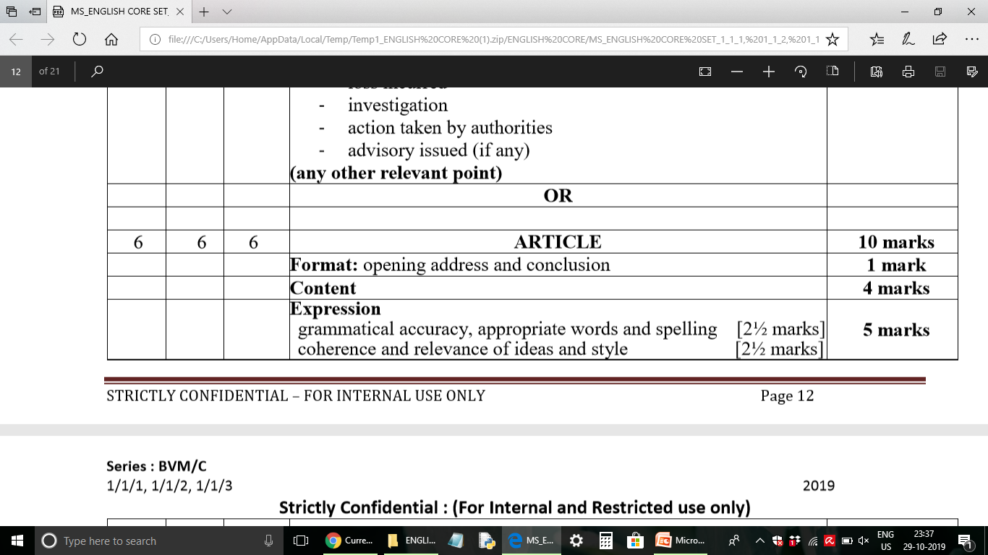

Marking Scheme of Article in Board Exam :-

Slide 6

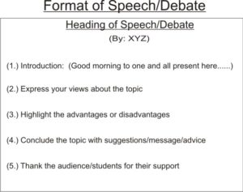
Format of Speech :-

Slide 7

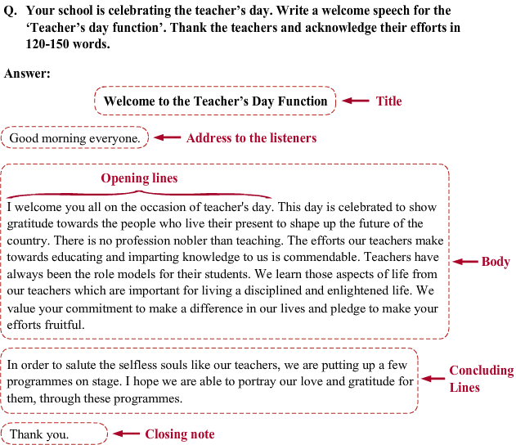
Example of speech writing :-

Slide 8
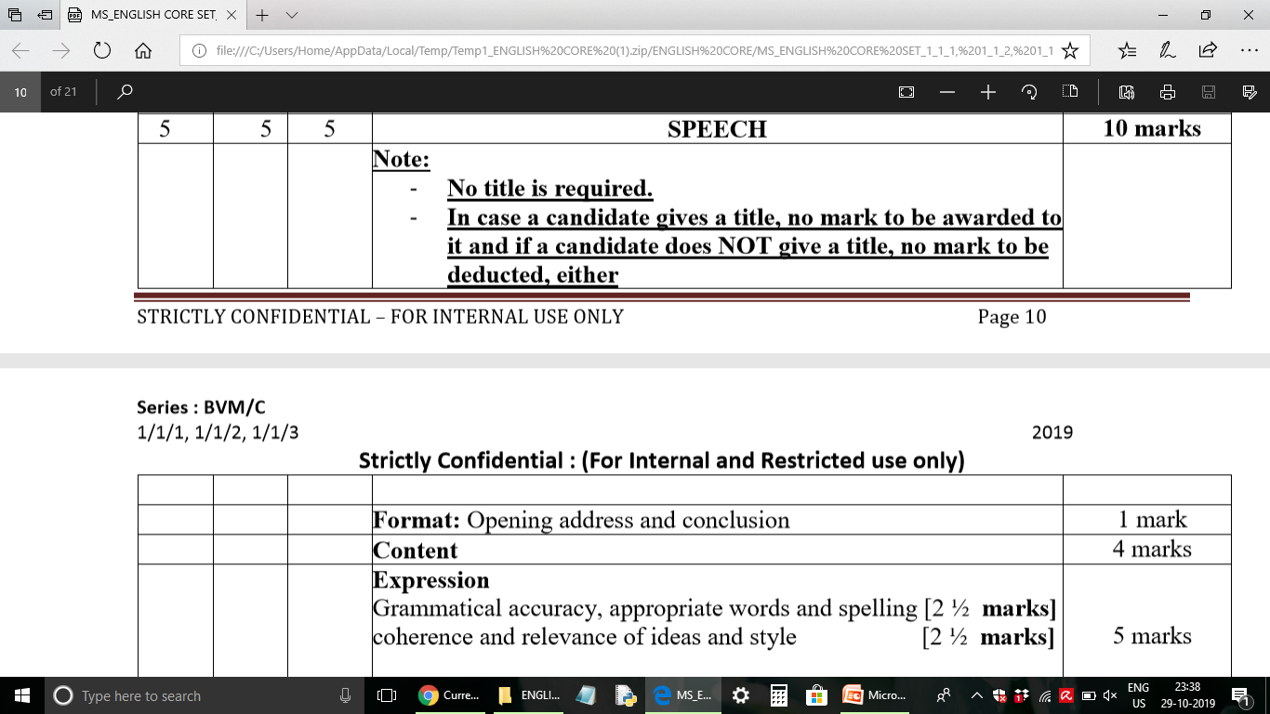


Marking Scheme of Speech in Board Exam :-

Slide 9


